Slide 1
Interior
Architectural
Design
2023

Slide 2
IAD Design Task 2023
Task: Create a building model in card, take photos, do drawings, make in Sketchup and present in a PowerPoint
Aim: To create and develop an architectural design
Select: Choose 1x from the following and make a building as shown in the steps below
Sky Scraper
Bridge
Museum
Sports Complex
Step 1: Create Card shapes- irregular triangle, wonky rectangles etc (you will need at least 10-15 different shapes)
Step 2: Fold, bend, twist your card shapes to make them more 3D
Step 3: Make your chosen building -Balance shapes against each other (no glue) to make a model (think what general shape your model needs to be- how is a bridge different to a Sky Scraper?)
Step 4: Take photos of your model low down viewpoints (take at least 15 photos)
Step 5: Rearrange your card parts to make another model of the same type and take the same number of photos as above
Step 6: Make your design in Sketchup
Step 7: Assemble all photos, drawings & Sketchup on a PowerPoint- present each model as a set of images on a page, you will have about 6-8 slides in total, each page might contain up to 5-10 photos of a single model
Step 8: Email your final PowerPoint to Ellie.smith@ncclondon.ac.uk by the 14 July
About Sketchup: It’s free 3D drawing software which you can use online here https://www.sketchup.com/plans-and-pricing/sketchup-free. DON’T install Sketchup Pro as it will only last for 30 days.
There are lots of videos on YouTube on how to use Sketchup and that is the best place to start learning it. Enjoy!
Please feel free to email me if you are stuck, unsure or have any questions.
Ellie Smith

Slide 3
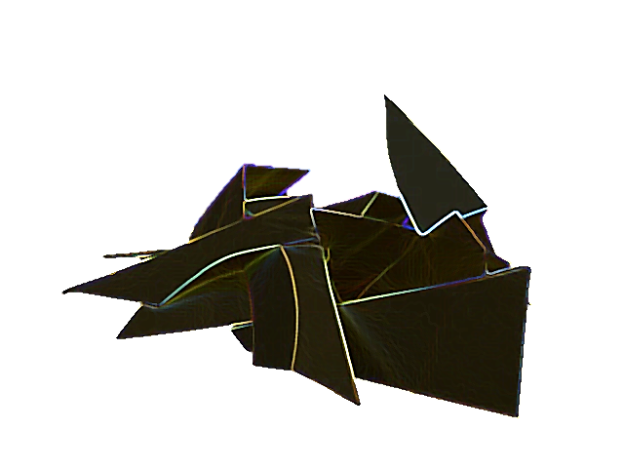
Layout idea and what your models might look like. Colour has been changed on PowerPoint

Slide 4
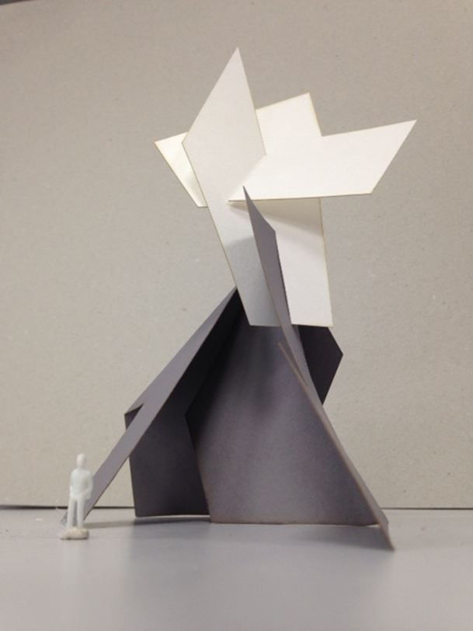
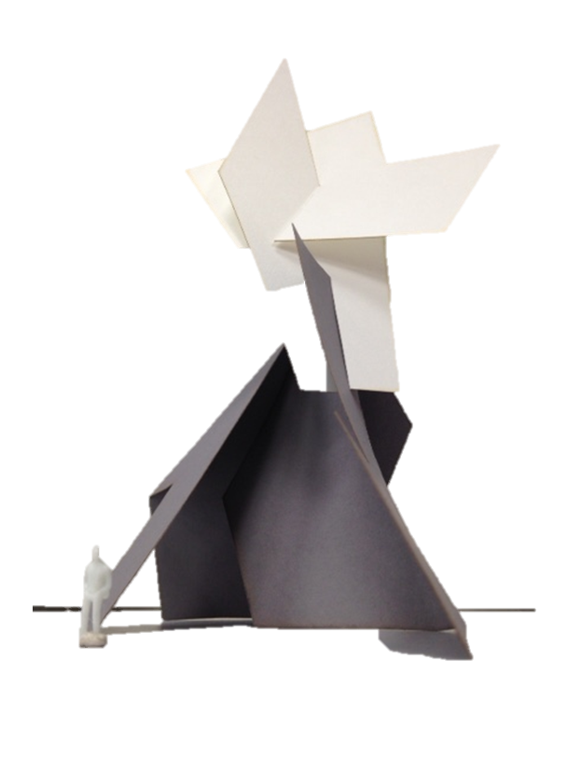
Photo of model with background
Photo of model with background removed-
You can do this in PowerPoint

Slide 5
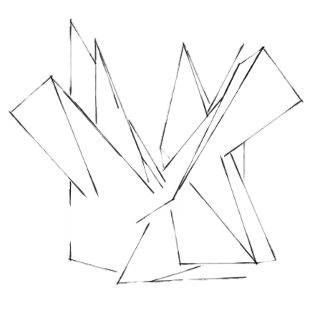
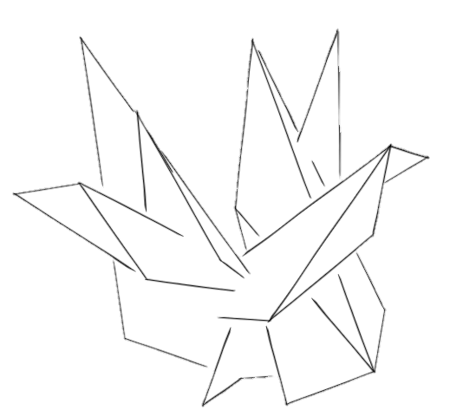
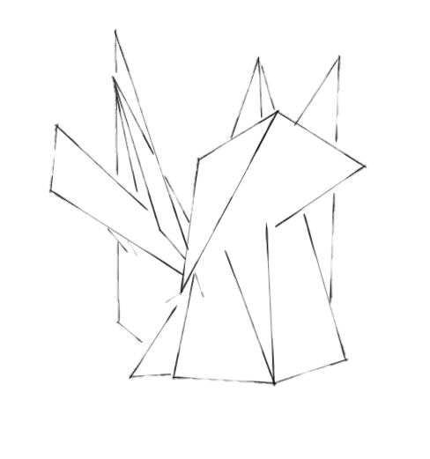
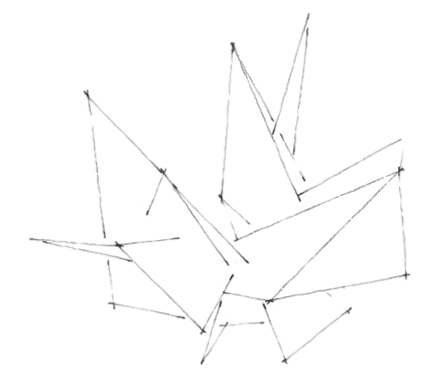
Create drawings of your models

Slide 6
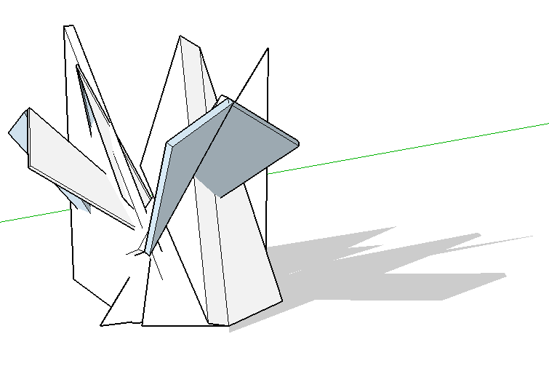
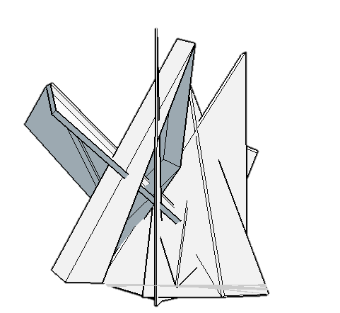
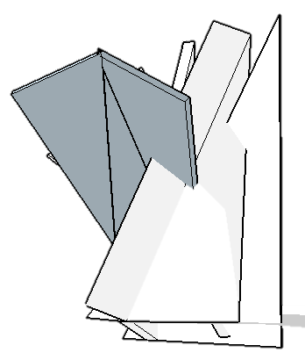
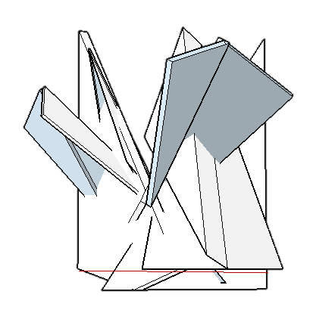
Sketchup drawing based on a Card Model with added Silhouette people

Slide 7
Real examples of Wonky Building Design

Slide 8
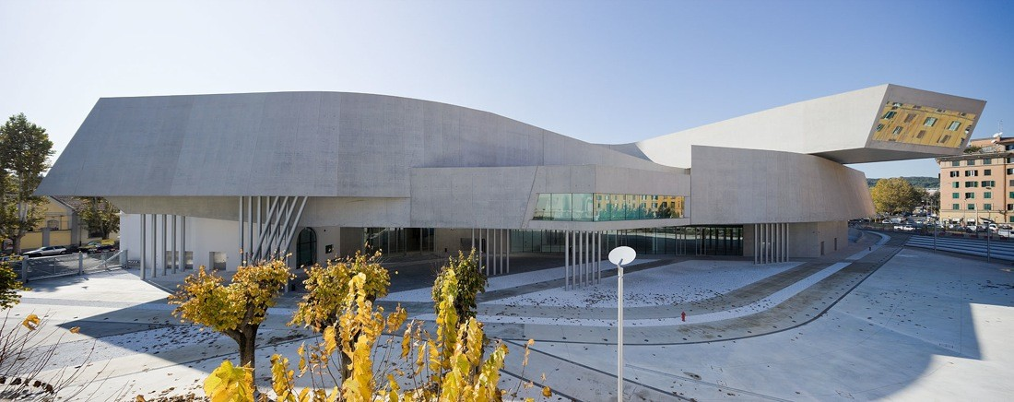
MAXXI Art Museum Rome 2009- Zaha Hadid

Slide 9
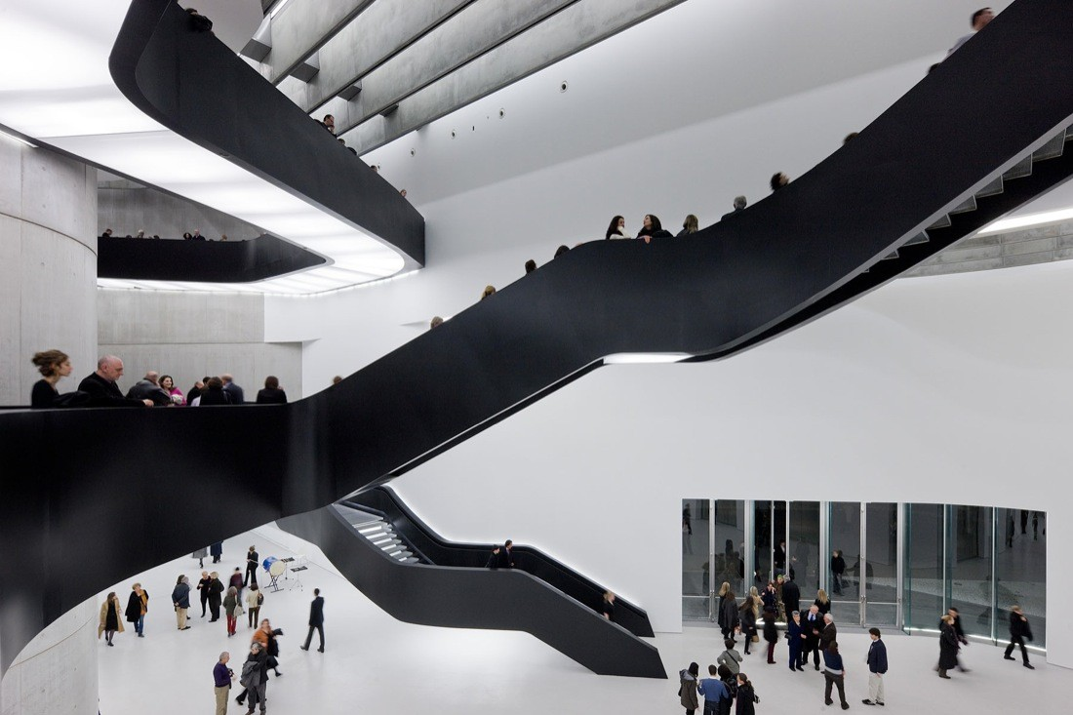
MAXXI Art Museum Rome 2009- Zaha Hadid- The Interior

Slide 10
MAXXI Art Museum Rome 2009- Zaha Hadid- Exterior and the site it sits on

Slide 11
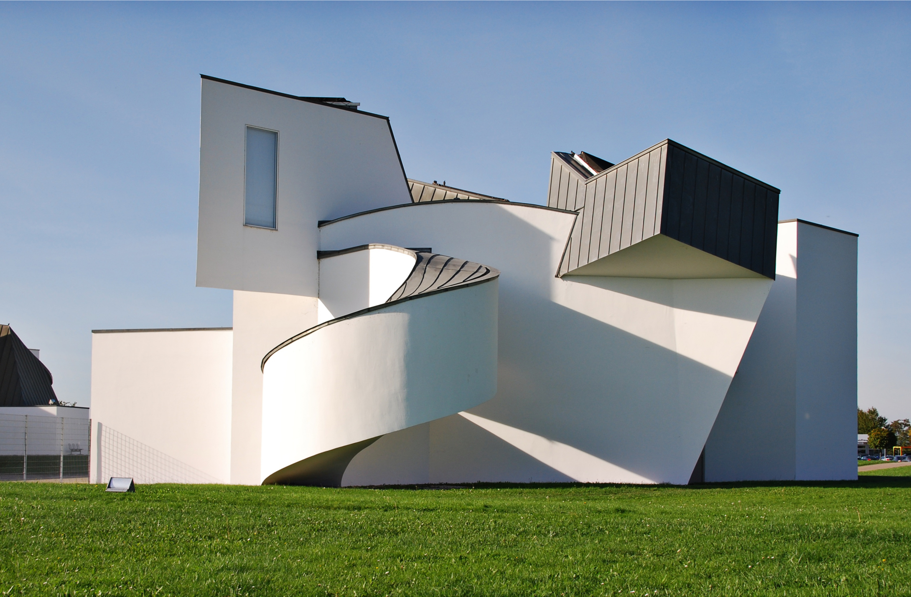
Vitra Design Museum 1989- Frank Gehry

Slide 12
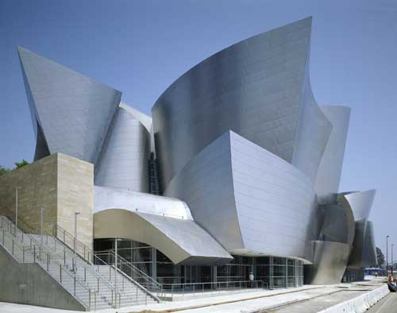
Walt Disney Concert Hall 2003- Frank Gehry

Slide 13
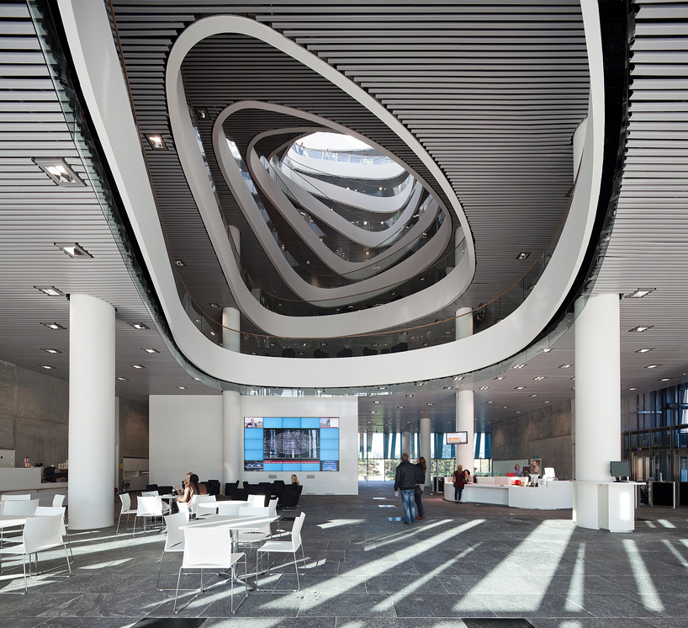

Slide 14
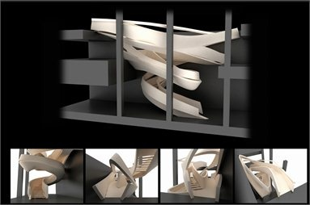
Armani shop NY

Slide 15
Architectural drawing with Barry Berkus
https://youtu.be/fwJB7KzDEbQ

